Slide 1
Clinical Supply Chain Modeling and Optimization
Enhancing efficiency in clinical supply operations
ASA Efficiency+ Clinical Supply Chain Subsection
Christi Kleoudis, Sr. Director Statistics, AstraZeneca
21 Nov 2025
Notes:
AI-generated content may be incorrect. --- This presentation explores the brainstorming outcomes from our kick-off meeting regarding clinical supply chain modeling and optimization. We will discuss optimization goals, key constraints, and current operational practices to enhance supply chain effectiveness in clinical settings.

Slide 2
Meeting Program
3 Stages of Clinical Supply Chain
Optimization Goals in Clinical Supply Chain
Key Constraints in Supply Chain Modeling
Notes:
We will cover three main areas: optimization goals in the clinical supply chain, key constraints impacting modeling, and current operational aspects and practices. Each section will break down into detailed subtopics for comprehensive understanding.

Slide 3
3 Stages of Clinical Supply Chain
Notes:
--- This slide references information from the following file: https://azcollaboration-my.sharepoint.com/personal/krff289_astrazeneca_net/_layouts/15/Doc.aspx?sourcedoc=%7B6EFA2A82-923F-40AE-891E-326CDC44A7E6%7D&file=BrainStorm%20from%20Kick-off%20Meeting_JNJcomment.docx&action=default&mobileredirect=true Drug minimization and inventory management, Stock-out tolerance and cost considerations, Protection of the blind and optimization levels

Slide 4
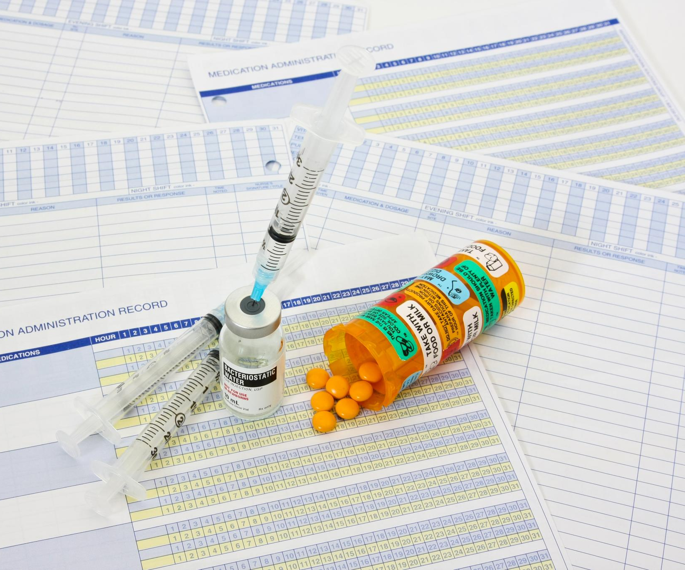
3 Stages of Clinical Supply Chain
Manufacturing Planning for Raw Drug Material
How much drug needs to be manufactured to support the clinical trial. This amount is prior to packaging. This may be measured as # tablets or volume of drug for injection.
Depot Stock (Central & Local)
The depots hold stock of packaged & label drug. Drug must be labeled in the language for the country it is intended. Labels may display 3-8 languages depending on package size or a booklet may be used which can hold up to 28 languages.
Site Supply
Number of drug kits at a site for each treatment.
Notes:
--- This slide references information from the following file: https://azcollaboration-my.sharepoint.com/personal/krff289_astrazeneca_net/_layouts/15/Doc.aspx?sourcedoc=%7B6EFA2A82-923F-40AE-891E-326CDC44A7E6%7D&file=BrainStorm%20from%20Kick-off%20Meeting_JNJcomment.docx&action=default&mobileredirect=true · Optimization goals o Drug minimization(minimize delta between consumed and shipped forecasts – “shots in arms” and inventory shipped?)
§ Initial site stock
§ resupply Image source: Microsoft 365 content library

Slide 5

Single vs. Multi- Echelon Optimization
Single-Echelon Optimization
Single-echelon optimization focuses on improving performance at one stage of a supply chain for efficiency and cost reduction.
Multi-Echelon Optimization
Multi-echelon optimization coordinates multiple supply chain stages to enhance overall system performance and reduce inventory costs (e.g., managing across depots and sites).
Notes:
--- This slide references information from the following file: https://azcollaboration-my.sharepoint.com/personal/krff289_astrazeneca_net/_layouts/15/Doc.aspx?sourcedoc=%7B6EFA2A82-923F-40AE-891E-326CDC44A7E6%7D&file=BrainStorm%20from%20Kick-off%20Meeting_JNJcomment.docx&action=default&mobileredirect=true Protection of the blind Multi-echelon or single-echelon optimization? Image source: Microsoft 365 content library

Slide 6
Optimization Goals in Clinical Supply Chain
Notes:
--- This slide references information from the following file: https://azcollaboration-my.sharepoint.com/personal/krff289_astrazeneca_net/_layouts/15/Doc.aspx?sourcedoc=%7B6EFA2A82-923F-40AE-891E-326CDC44A7E6%7D&file=BrainStorm%20from%20Kick-off%20Meeting_JNJcomment.docx&action=default&mobileredirect=true Drug minimization and inventory management, Stock-out tolerance and cost considerations, Protection of the blind and optimization levels

Slide 7
Drug minimization
Optimization Goals
Optimization goals are dependent on the relationship of drug availability, costs, and tolerance for stock out.
Initial Site Stock
Begin with an optimized initial stock level to balance supply and demand effectively at the site.
Resupply Process
Efficient resupply plans ensure continuous availability with minimal excess or shortage.
Notes:
--- This slide references information from the following file: https://azcollaboration-my.sharepoint.com/personal/krff289_astrazeneca_net/_layouts/15/Doc.aspx?sourcedoc=%7B6EFA2A82-923F-40AE-891E-326CDC44A7E6%7D&file=BrainStorm%20from%20Kick-off%20Meeting_JNJcomment.docx&action=default&mobileredirect=true · Optimization goals o Drug minimization(minimize delta between consumed and shipped forecasts – “shots in arms” and inventory shipped?)
§ Initial site stock
§ resupply Image source: Microsoft 365 content library

Slide 8

Stock-out tolerance
Stock-out tolerance definition: A stock-out occurs when no study drug is available at the depot or site at the time of shipment or dispensing for a newly randomized patient or a returning patient needing re-supply.
Decision factors: Teams should balance drug minimization goals, logistics costs, and the risk of losing a patient when setting an acceptable stock-out tolerance.
Example tolerance range: Many teams target a 0%–5% stock-out tolerance, depending on study priorities and operational constraints.
Notes:
--- This slide references information from the following file: https://azcollaboration-my.sharepoint.com/personal/krff289_astrazeneca_net/_layouts/15/Doc.aspx?sourcedoc=%7B6EFA2A82-923F-40AE-891E-326CDC44A7E6%7D&file=BrainStorm%20from%20Kick-off%20Meeting_JNJcomment.docx&action=default&mobileredirect=true o No tolerance for stock out o Costs not associated with drug production (shipping costs, packaging costs) Image source: Microsoft 365 content library

Slide 9

Non-production cost considerations
Beyond production costs: Shipping and packaging are significant contributors to total study drug costs.
Trade-off—wastage vs. shipment frequency: Reducing drug wastage may require smaller, more frequent shipments, which increases packaging and shipping expenses.
Cold-chain implications: If the drug requires refrigeration, costs rise because temperature-controlled packaging and refrigerated transport are more expensive; in some cases, accepting more drug wastage can be economically preferable to frequent cold-chain shipments.
Stock-out consequences: Excessive stock-outs can lead to lost patients and extended recruitment timelines, incurring additional operational costs.
Commercial timing risk: With a finite patent life, study delays reduce the period of commercial exclusivity, limiting the window for profitability.
Notes:
--- This slide references information from the following file: https://azcollaboration-my.sharepoint.com/personal/krff289_astrazeneca_net/_layouts/15/Doc.aspx?sourcedoc=%7B6EFA2A82-923F-40AE-891E-326CDC44A7E6%7D&file=BrainStorm%20from%20Kick-off%20Meeting_JNJcomment.docx&action=default&mobileredirect=true o No tolerance for stock out o Costs not associated with drug production (shipping costs, packaging costs) Image source: Microsoft 365 content library

Slide 10
Key Constraints in Supply Chain Modeling
Notes:
--- This slide references information from the following file: https://azcollaboration-my.sharepoint.com/personal/krff289_astrazeneca_net/_layouts/15/Doc.aspx?sourcedoc=%7B6EFA2A82-923F-40AE-891E-326CDC44A7E6%7D&file=BrainStorm%20from%20Kick-off%20Meeting_JNJcomment.docx&action=default&mobileredirect=true Labeling, depot numbers, and customs clearance, Shelf life, temperature, and patient expectations, Randomization schemes and allocation ratios, Resupply logistics and adaptive safety stock, Shipment frequency and demand uncertainty, Screen fail rates and shipment triggers

Slide 11
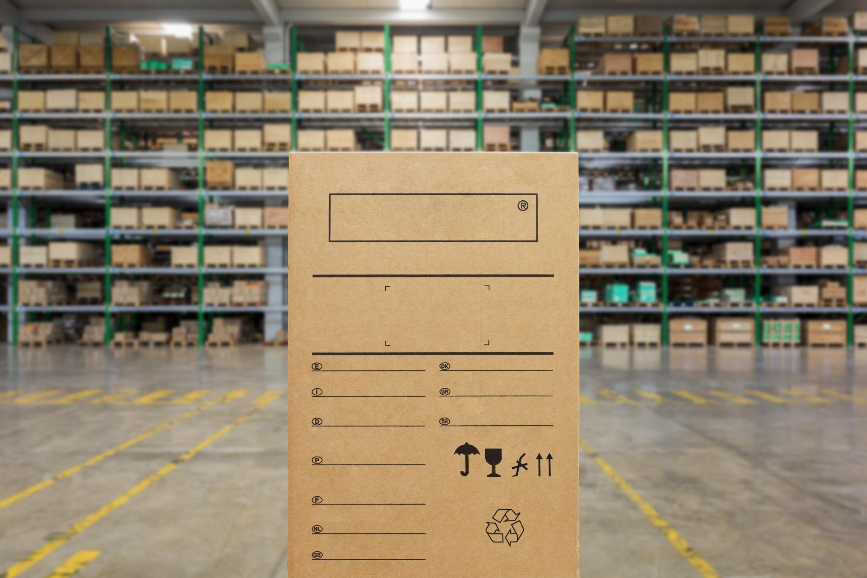
Labeling, Number of Depots, and Enrollment Expectations
Multi-lingual Labeling
The number of languages on labels affects kit availability at depots across countries and sites.
Depot Quantity
The total number of depots influences logistics and inventory distribution efficiency.
Patient Enrollment Expectations
Estimating expected patients per site involves predicting recruitment per country and site.
Notes:
--- This slide references information from the following file: https://azcollaboration-my.sharepoint.com/personal/krff289_astrazeneca_net/_layouts/15/Doc.aspx?sourcedoc=%7B6EFA2A82-923F-40AE-891E-326CDC44A7E6%7D&file=BrainStorm%20from%20Kick-off%20Meeting_JNJcomment.docx&action=default&mobileredirect=true o How many languages can be placed on the label (dictates the available pool of kits per depot/country/site). o Number of depots. Time required to clear customs within the country. Image source: Microsoft 365 content library

Slide 12
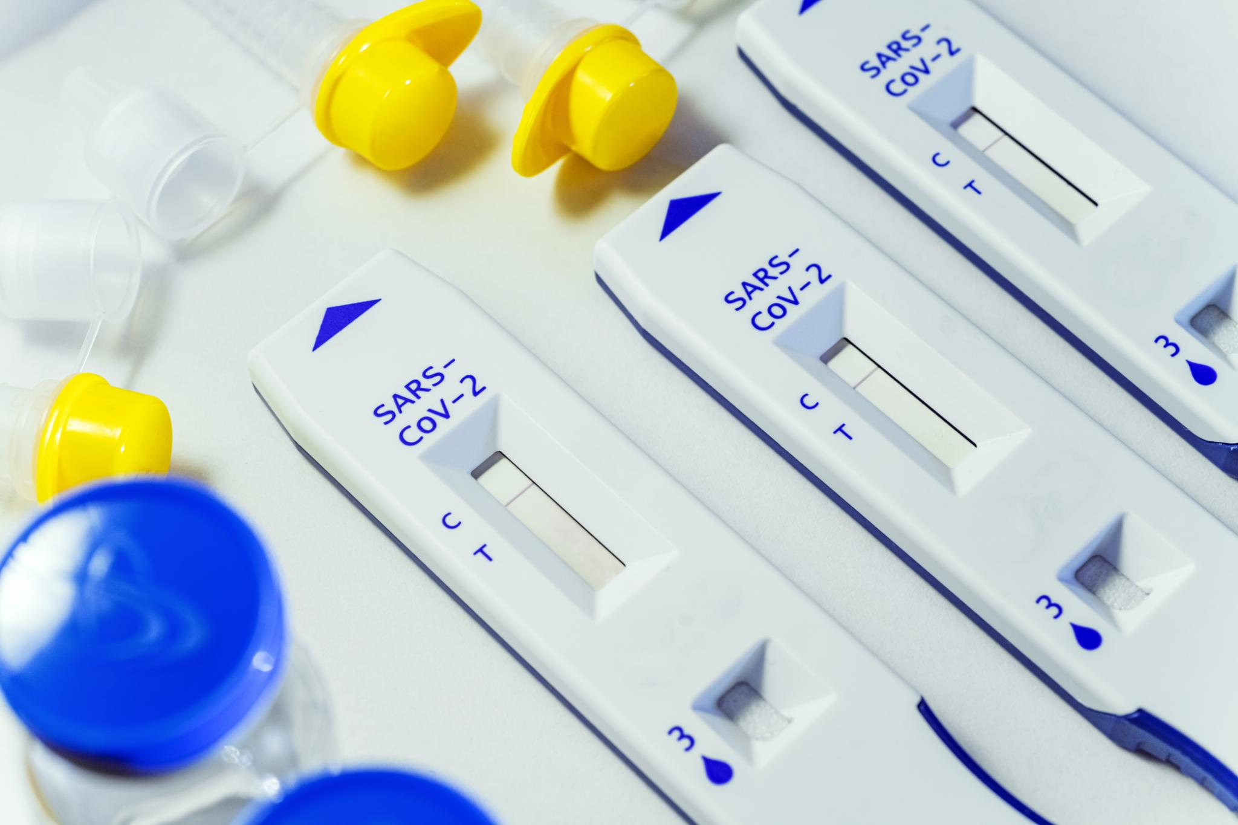
Shelf life and Temperature
Shelf Life and Expiry
Understanding shelf life, expiry dates, and damage helps ensure product safety and effectiveness. Different countries impose varying shelf-life requirements impacting drug selection and packing decisions.
Temperature Restrictions
Proper temperature management, including cold storage or room temperature, is critical to maintain product integrity.
Notes:
--- This slide references information from the following file: https://azcollaboration-my.sharepoint.com/personal/krff289_astrazeneca_net/_layouts/15/Doc.aspx?sourcedoc=%7B6EFA2A82-923F-40AE-891E-326CDC44A7E6%7D&file=BrainStorm%20from%20Kick-off%20Meeting_JNJcomment.docx&action=default&mobileredirect=true o Shelf life/expiry/damaged. o Temperature restrictions (cold storage or room temperature) o Expected patients/site (range, high enrollers, median, average) Image source: Microsoft 365 content library

Slide 13

Resupply Lead Time and Adaptive Stock Levels
Resupply Lead Time
Time from resupply notification to delivery. Depending if resupply is for the central/local depot resupply or a site, lead time may include packaging, transportation, and clearing customs.
Adaptive Stock
Stock levels adjust dynamically based on demand variability during trial lifecycle.
Sources of demand variability include
slowing of patients in screening,
patients discontinuing treatment prematurely, and
close of recruitment.
Notes:
--- This slide references information from the following file: https://azcollaboration-my.sharepoint.com/personal/krff289_astrazeneca_net/_layouts/15/Doc.aspx?sourcedoc=%7B6EFA2A82-923F-40AE-891E-326CDC44A7E6%7D&file=BrainStorm%20from%20Kick-off%20Meeting_JNJcomment.docx&action=default&mobileredirect=true o Time required from notification of resupply to actually getting drug to depot/site – is this lead team inclusive of packaging & transportation to local depot or depot to site? o Adaptive safety stock level setting (ie demand variability changes throughout lifecyle of trial) Image source: Microsoft 365 content library

Slide 14

Shipment frequency and Demand uncertainty
Shipment Frequency Definition
Shipment frequency is determined by product type, stocking cost, product cost, and demand factors.
Demand Uncertainty in Kits
Certain kits have high demand uncertainty due to titration designs, adaptive designs, dosing based on weight or body surface area, and rescue medication use.
Notes:
--- This slide references information from the following file: https://azcollaboration-my.sharepoint.com/personal/krff289_astrazeneca_net/_layouts/15/Doc.aspx?sourcedoc=%7B6EFA2A82-923F-40AE-891E-326CDC44A7E6%7D&file=BrainStorm%20from%20Kick-off%20Meeting_JNJcomment.docx&action=default&mobileredirect=true o Shipment frequency user defined or calculated value based on the product, the stocking cost, the product cost, demands, etc? o Certain kits have high level of demand uncertainty- dose levels, titration, rescue meds, etc Image source: Microsoft 365 content library

Slide 15
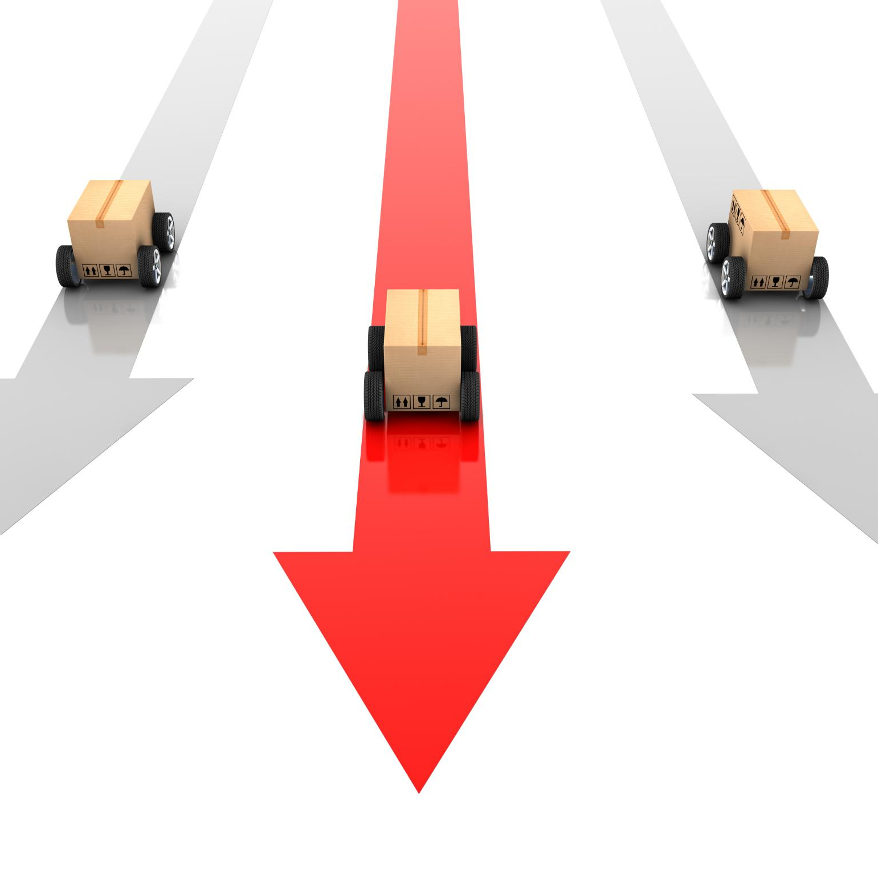
Shipment triggers and Screen fail rates
Shipment Triggers
Drug shipment to site is triggered based on the number of patients in screening.
Screen Fail Rates
Screen fail rates measure the proportion of screened patients failing to qualify for randomization to treatment.
Screening Windows
Screening windows define the maximum time from screening a patient to having drug available at the site for the screened patient, assuming the patient qualifies for randomization.
Notes:
--- This slide references information from the following file: https://azcollaboration-my.sharepoint.com/personal/krff289_astrazeneca_net/_layouts/15/Doc.aspx?sourcedoc=%7B6EFA2A82-923F-40AE-891E-326CDC44A7E6%7D&file=BrainStorm%20from%20Kick-off%20Meeting_JNJcomment.docx&action=default&mobileredirect=true Screen fail rates, screening windows, etc (what triggers shipment to site)? Image source: Microsoft 365 content library

Slide 16
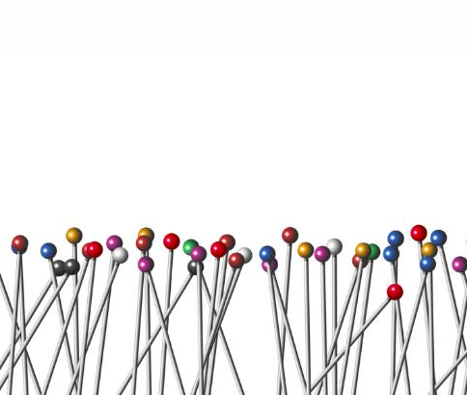
Randomization characteristics affect predictability of treatment assignment
Types of Randomization
By site, region, centralized or adaptive.
Randomization Blocksize
Number of participants in which allocation ratio is maintained preventing long runs of one treatment that can occur in a simple randomization.
Treatment Allocation Ratio
The proportion of participants assigned to each treatment group.
Stratified Randomization
Stratification may decrease predictability at a site if
blocksize and/or allocation ratio varies across strata, and/or
many strata relative to the number of patients per site resulting in split blocks at the site level
Notes:
--- This slide references information from the following file: https://azcollaboration-my.sharepoint.com/personal/krff289_astrazeneca_net/_layouts/15/Doc.aspx?sourcedoc=%7B6EFA2A82-923F-40AE-891E-326CDC44A7E6%7D&file=BrainStorm%20from%20Kick-off%20Meeting_JNJcomment.docx&action=default&mobileredirect=true o Central randomization, adaptive, by site o Randomization blocksize o Treatment allocation ratio o If randomization is stratified, is the allocation ratio/blocksize the same across strata Image source: Microsoft 365 content library

Slide 17
Conclusion
Understanding Goals
A clear understanding of clinical supply chain goals is essential to guide optimization efforts effectively.
Addressing Constraints
Identifying and managing constraints helps streamline operations and overcome supply chain challenges.
Operational Realities
Considering real-world operational factors ensures feasible and sustainable supply chain improvements.
Improved Efficiency and Reliability
Optimized supply chains reduce costs and ensure consistent availability of drugs for trials.
Notes:
Optimizing the clinical supply chain requires a deep understanding of goals, constraints, and operational realities. By addressing these areas, we can improve efficiency, reduce costs, and ensure reliable drug availability for clinical trials.

Slide 18
Current Operational Aspects and Practices
Notes:
--- This slide references information from the following file: https://azcollaboration-my.sharepoint.com/personal/krff289_astrazeneca_net/_layouts/15/Doc.aspx?sourcedoc=%7B6EFA2A82-923F-40AE-891E-326CDC44A7E6%7D&file=BrainStorm%20from%20Kick-off%20Meeting_JNJcomment.docx&action=default&mobileredirect=true RTSM management and vendor practices, Kit storage and distribution center practices, Additional constraints in drug selection and packing

Slide 19

RTSM management and vendor practices
RTSM Management Approach
Randomization and Trial Supply Management is often handled through a vendor.
Drug Optimization Status
It varies whether drug optimization methods are used within the RTSM vendor practices.
Notes:
--- This slide references information from the following file: https://azcollaboration-my.sharepoint.com/personal/krff289_astrazeneca_net/_layouts/15/Doc.aspx?sourcedoc=%7B6EFA2A82-923F-40AE-891E-326CDC44A7E6%7D&file=BrainStorm%20from%20Kick-off%20Meeting_JNJcomment.docx&action=default&mobileredirect=true o Is Randomization and Trial Supply Management (RTSM) managed internally or through a vendor JNJ: through a vendor o If a vendor, do they already employ a drug optimization? If so, what is the primary goal of the optimization? JNJ:Not currently in use Image source: Microsoft 365 content library

Slide 20

Kit storage & Shelf Life
Kit storage and distribution center practices
Kits in the distribution center are stored in a sequential order to facilitate easy tracking and retrieval.
Shelf-Life Restrictions
Different countries impose varying shelf-life requirements impacting drug selection and packing decisions.
Notes:
--- This slide references information from the following file: https://azcollaboration-my.sharepoint.com/personal/krff289_astrazeneca_net/_layouts/15/Doc.aspx?sourcedoc=%7B6EFA2A82-923F-40AE-891E-326CDC44A7E6%7D&file=BrainStorm%20from%20Kick-off%20Meeting_JNJcomment.docx&action=default&mobileredirect=true o Are there other constraints for selecting drug and packing it to be shipped to the depot/site. JNJ: Some countries have more restrictive shelf-life (SL) requirements than others Image source: Microsoft 365 content library

Slide 21

Kit storage and distribution center practices
Kits in the distribution center are stored in a sequential order to facilitate easy tracking and retrieval.
Notes:
--- This slide references information from the following file: https://azcollaboration-my.sharepoint.com/personal/krff289_astrazeneca_net/_layouts/15/Doc.aspx?sourcedoc=%7B6EFA2A82-923F-40AE-891E-326CDC44A7E6%7D&file=BrainStorm%20from%20Kick-off%20Meeting_JNJcomment.docx&action=default&mobileredirect=true o How are the kits stored in the distribution center (e.g., are the kit numbers sequential or in random order) JNJ: kit numbers sequential Image source: Microsoft 365 content library

